Slide 2
Investigation 4: Osmosis and Diffusion
Please make an assigned solutions as needed.
Group 1a: 1L of1M sucrose 1b: 1L of 0.6 M sucrose
Group 2a: ,5L of 1M NaCl 2b: 1L of 0.4 M sucrose
Group 3a: .5L 1M glucose 3b: 1L of 0.2 M sucrose
Group 4: 5% ovalbumin (egg white protein)
Group 5a: 1 L of 1 M sucrose 5b: 1L of 0.0M sucrose
Group 6a: 1 L of 0.8 M sucrose
6b: Assemble and distribute per group: 5 plastic cups,
goggles, 5 pieces of soaking dialysis tubing, a compound
microscope, a slide and cover slip, cork borer set
Part 1: Surface Area and Cell Size. We will demo the agar cubes.
Part 2: Modeling Diffusion and Osmosis
Part 3: Observing Osmosis in a Living Cell
Preparing for this lab
Cut and soak dialysis tubing.
Make solutions
GFM of sucrose is 342g/mol
GFM of NaCl is 58.44g/mol
GFM of glucose is 180g/mol
Ovalbumin: Mix 50g per liter
General instructions for solutions are in Dropbox.
Any safety concerns?
Notes:
Cut Onion

Slide 3
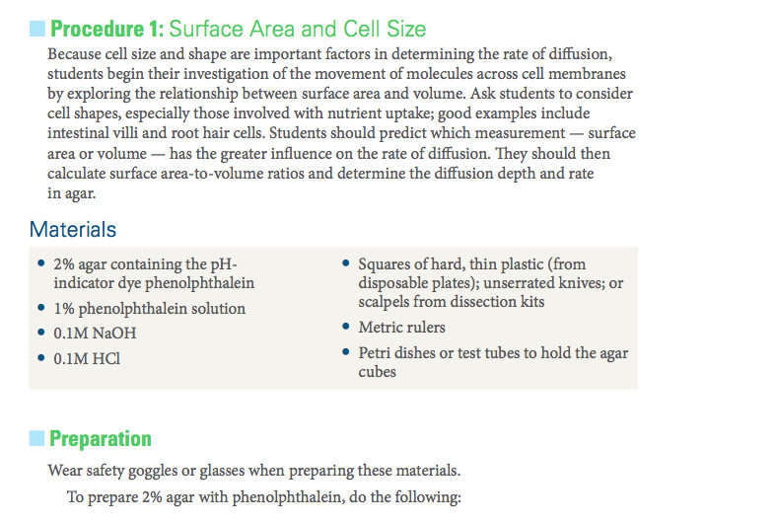
Investigation 4
Part 1
Demo Only
Notes:
I might just open this up.

Slide 4
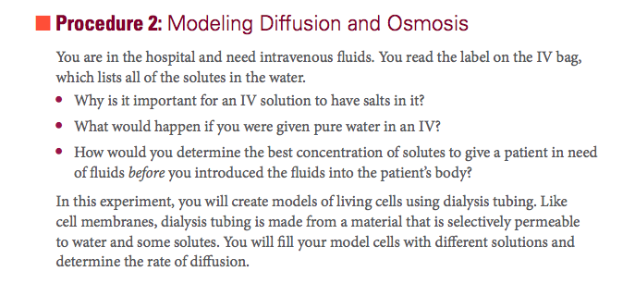
Investigation 4
Part 2

Slide 5
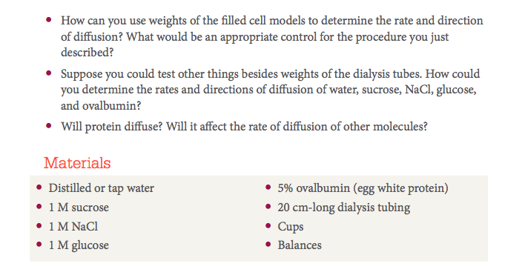
Investigation 4
Part 2

Slide 6
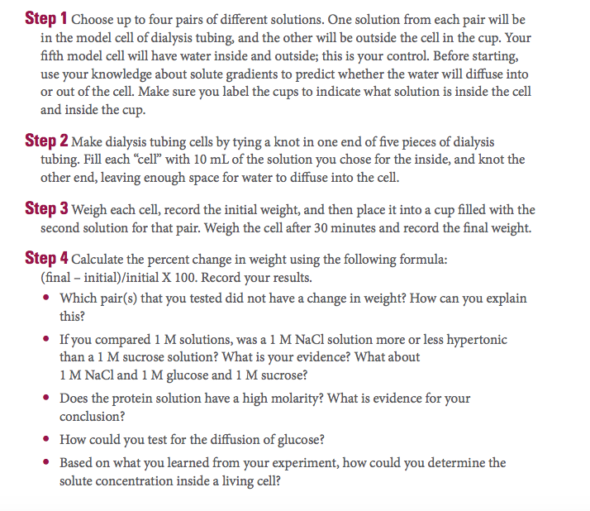
Investigation 4
Part 2, Con’t.
Your Report Out: Poster with Gallery Walk
Complete part 2. Make a poster. You will have results, BUT the point is using and noting the science practices.
Include as many Science Practices as you can and label them on your poster. See Lesson 6 p.47 WB for guidance.
Think about the parts of each science practice. Would the students have worked with it before? Are you introducing the skill or practicing it? Make notes on poster.

Slide 7
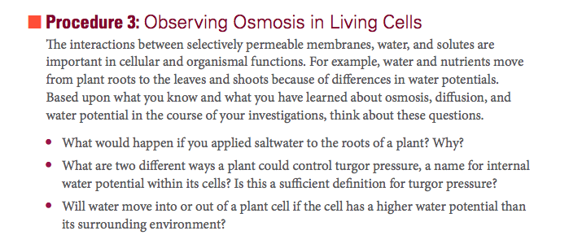
Investigation 4
Part 3
There is a second PowerPoint in your Dropbox for this lab.

Slide 8
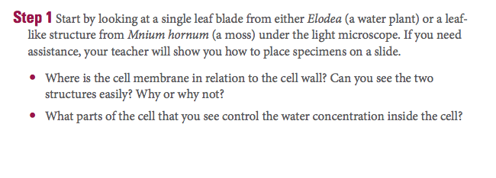
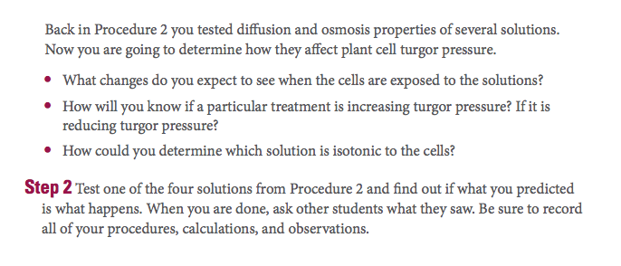
Investigation 4
Part 3
We will used red onion. Dice before distributing.

Slide 9
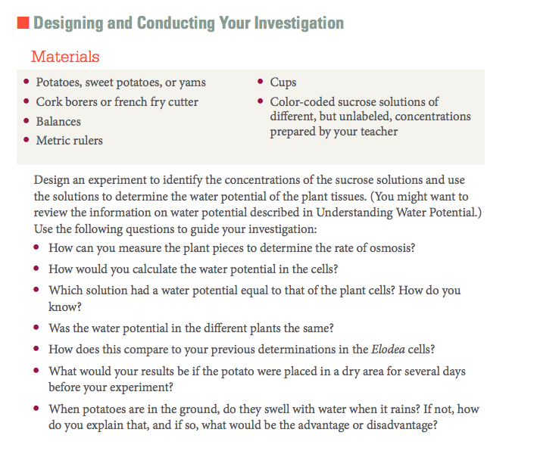
Investigation 4
Part 3
Your report out: Poster presentation
Focus on Science Practice 4. p. 117 WB.
Water Potential Calculations.
Final mass will be taken tomorrow.
Notes:
Extra Time? Go back to p. 19 in the WB to look at exam questions.

