Slide 1
Onion Osmosis

Slide 2
Before Starting…
You need to have
  A compound microscope
  A diced red onion
  A slide and cover slip
  Forceps
  Some tap water
  Some 15% salt solution and a pipette
  A piece of paper towel

Slide 3
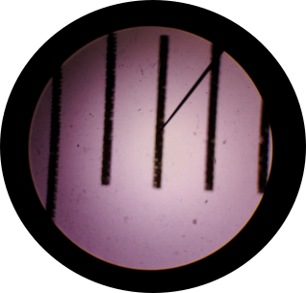
How to: Microscopic Measurement
Determine the diameter of your “field of view.”
1. Begin with a clear ruler.
2. Place on the stage, visible under the lowest magnification for your microscope.
3. Determine the diameter of the field of view in mm.
4. 1mm=1000 Micrometers (μm)
1 mm

Slide 4
How to: FOV under a higher power lens
For a higher power, you need to calculate the field of view.

Slide 5
Zoom in
Original Objective | New Objective | Original FOV (μm) | New FOV
4x | 10x | 4500 | 1800
4x | 40x | 4500 | 450
4x | 100x | 4500 | 180
(Original Obj/New Obj) x Original FOV=New FOV
FOV=Field of View
5

Slide 6
Onion Osmosis

Slide 7
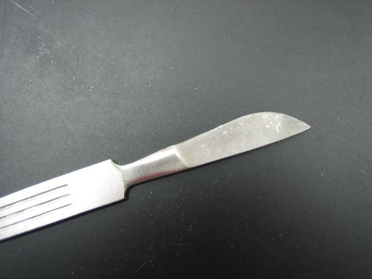
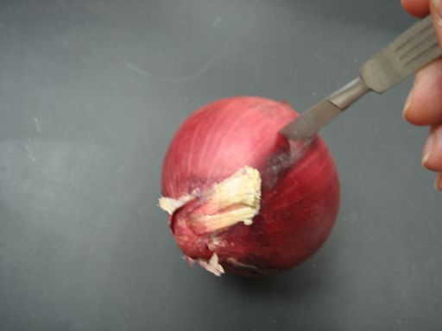
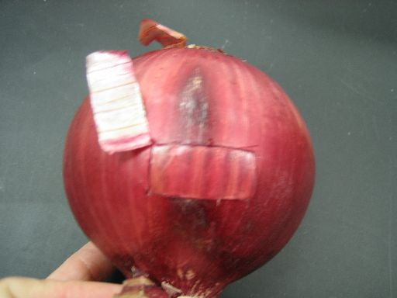
Cut a piece of outer pigmented tissue

Slide 8
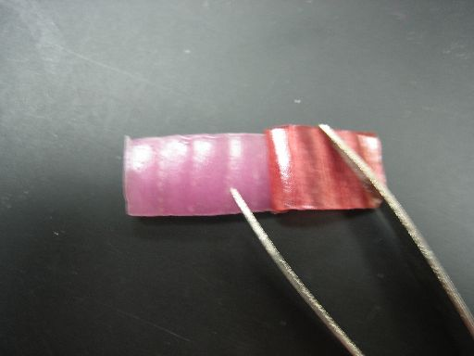
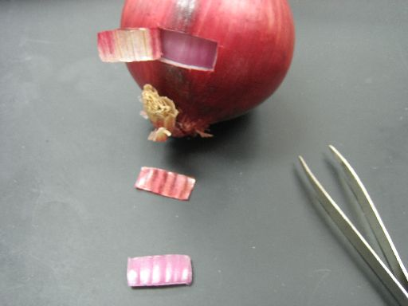
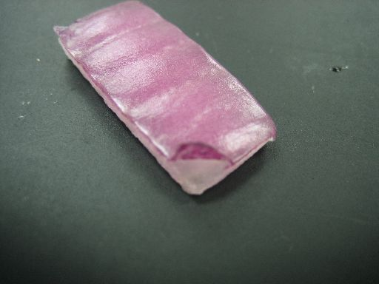

Slide 9
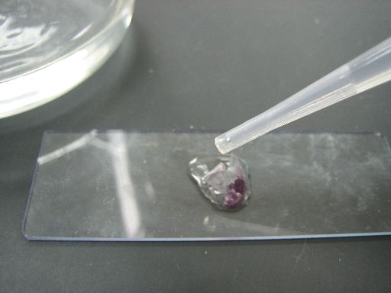
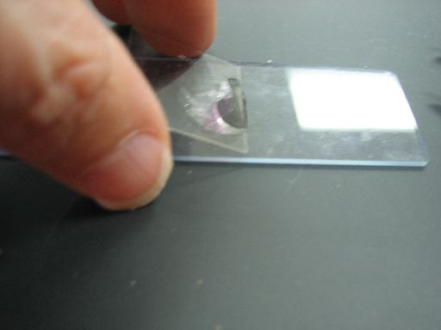
Make a wet mount with tap water

Slide 10
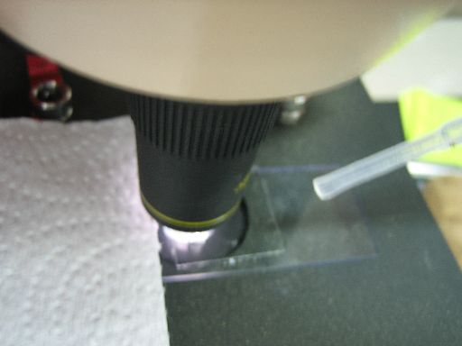
Add concentrated salt solution. Hurry…you will want to watch!

Slide 11
Questions?
What if…..
Can I…
How do I…
Jot them down.

Slide 12
Let’s try to answer them.
Can you focus your question to use the materials we have available?
Does your question deal with osmosis? This is the concept our trial focused on. Can you focus your question on osmosis?

Slide 13
Modeling
After you form a question, model what you think will happen with model pieces.
Get the OK from your teacher then check it out.
Keep good records.

Slide 14
A slide of red onion cells.
OnionCell
Which way will water move if a concentrated sugar solution is added?
Show this with your models.

Slide 15
Going further:
Consider taking a picture through the microscope. Analyze with Image J.

Slide 16
Image J
Download for free from NIH.

Slide 17
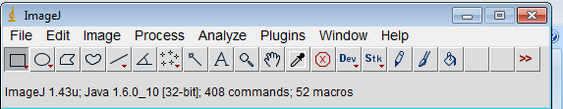
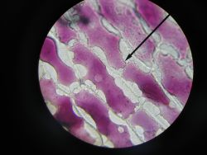
Determining Percent Change in Area
Find your picture file and open it.

Slide 18
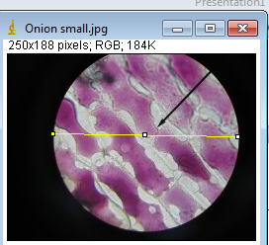
To get area and perimeter...
Select the straight line tool. Drag across your field of view.

Slide 19
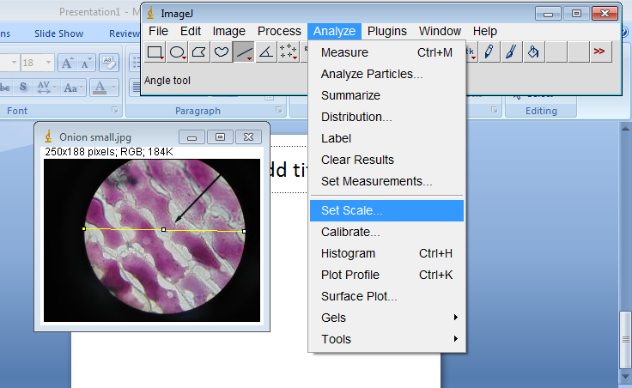
Under analyze: Set scale

Slide 20
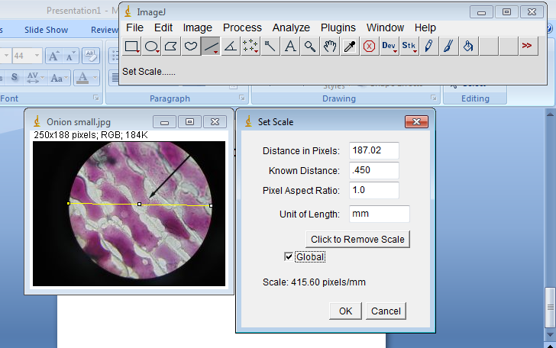
Pixels are already there. Enter your known distance.

Slide 21
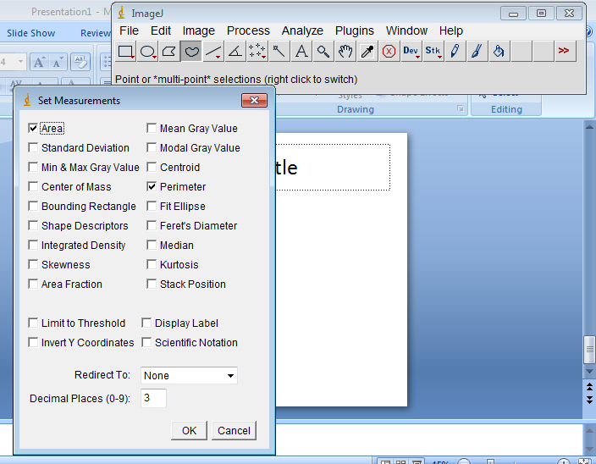
Analyze: Set Measurements

Slide 22
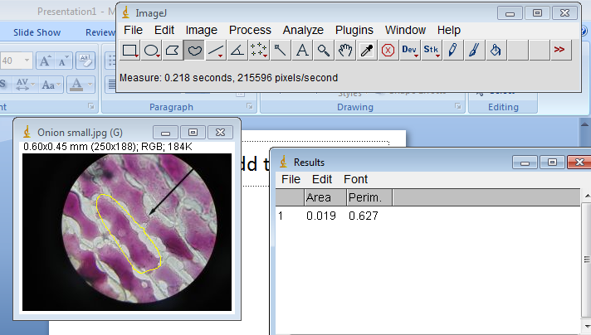
Trace with the freehand tool
Go to analyze: Measure
Compare before and after

